Slide 1
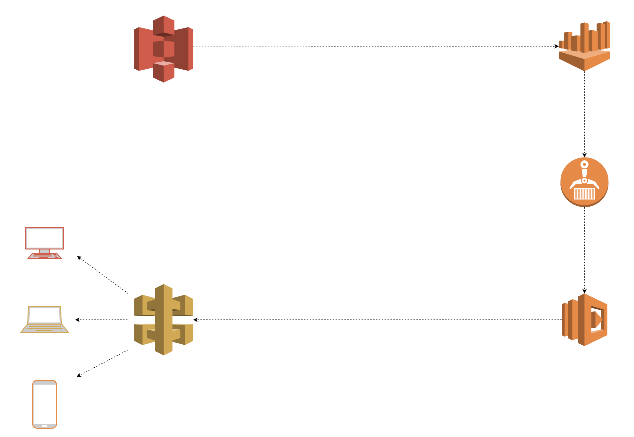
It’s serverless all the way down!
Using serverless technologies to build, deploy, and serve scalable data pipelines

Slide 2

Who has used serverless technologies?

Slide 3
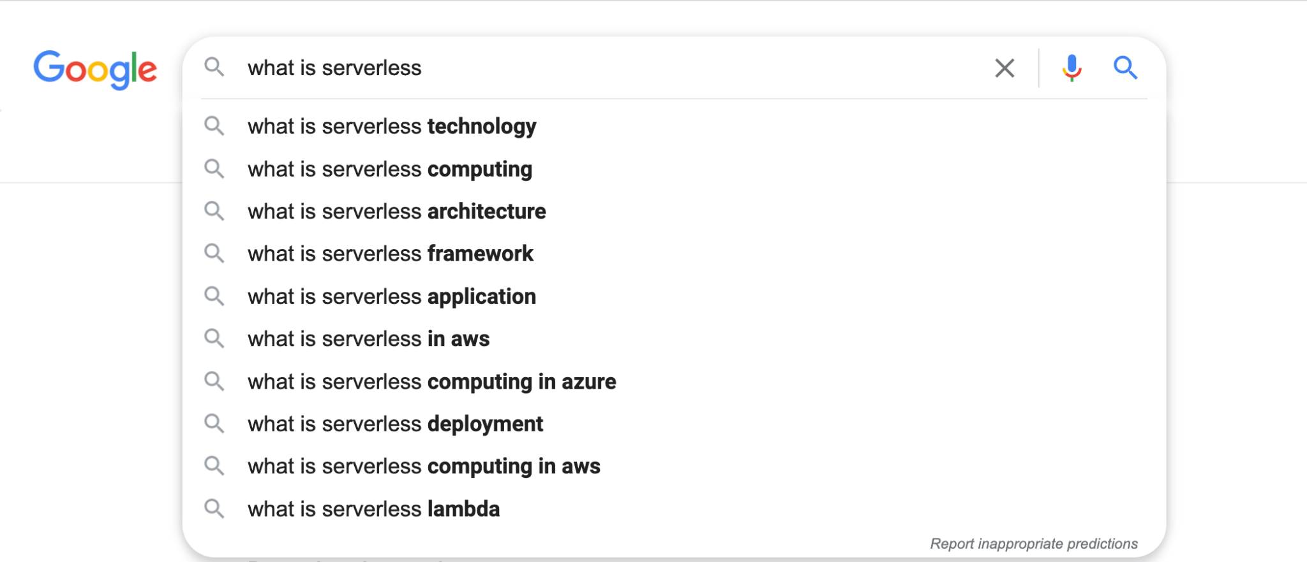

Slide 4
Why go serverless?

Slide 5
Why go serverless?
Eliminates server maintenance

Slide 6
Why go serverless?
Eliminates server maintenance
Only pay for what you use

Slide 7
Why go serverless?
Eliminates server maintenance
Only pay for what you use
Inherently and automatically scalable

Slide 8
Why go serverless?
Eliminates server maintenance
Only pay for what you use
Inherently and automatically scalable
Easy to deploy

Slide 9
When to go serverless?

Slide 10
When to go serverless?
Non-constant workload

Slide 11
When to go serverless?
Non-constant workload
Volume-varying requests

Slide 12
When to go serverless?
Non-constant workload
Volume-varying requests
Non-low latency requirements

Slide 13
When to go serverless?
Non-constant workload
Volume-varying requests
Non-low latency requirements
If you’ve asked “how can i meet these requirements with a service that’s always available at a low cost?”

Slide 14
When to NOT go serverless?
Notes:
https://www.serverless.com/blog/when-why-not-use-serverless
https://pauldjohnston.medium.com/when-not-to-use-serverless-jeff-6d054d0e7098

Slide 15
When to NOT go serverless?
Low latency responses
Notes:
https://www.serverless.com/blog/when-why-not-use-serverless
https://pauldjohnston.medium.com/when-not-to-use-serverless-jeff-6d054d0e7098

Slide 16
When to NOT go serverless?
Low latency responses
High memory computations
Notes:
https://www.serverless.com/blog/when-why-not-use-serverless
https://pauldjohnston.medium.com/when-not-to-use-serverless-jeff-6d054d0e7098

Slide 17
When to NOT go serverless?
Low latency responses
High memory computations
Long running tasks
Notes:
https://www.serverless.com/blog/when-why-not-use-serverless
https://pauldjohnston.medium.com/when-not-to-use-serverless-jeff-6d054d0e7098

Slide 18
When to NOT go serverless?
Low latency responses
High memory computations
Long running tasks
Many tasks interacting with each other and require statefulness
Notes:
https://www.serverless.com/blog/when-why-not-use-serverless
https://pauldjohnston.medium.com/when-not-to-use-serverless-jeff-6d054d0e7098

Slide 19
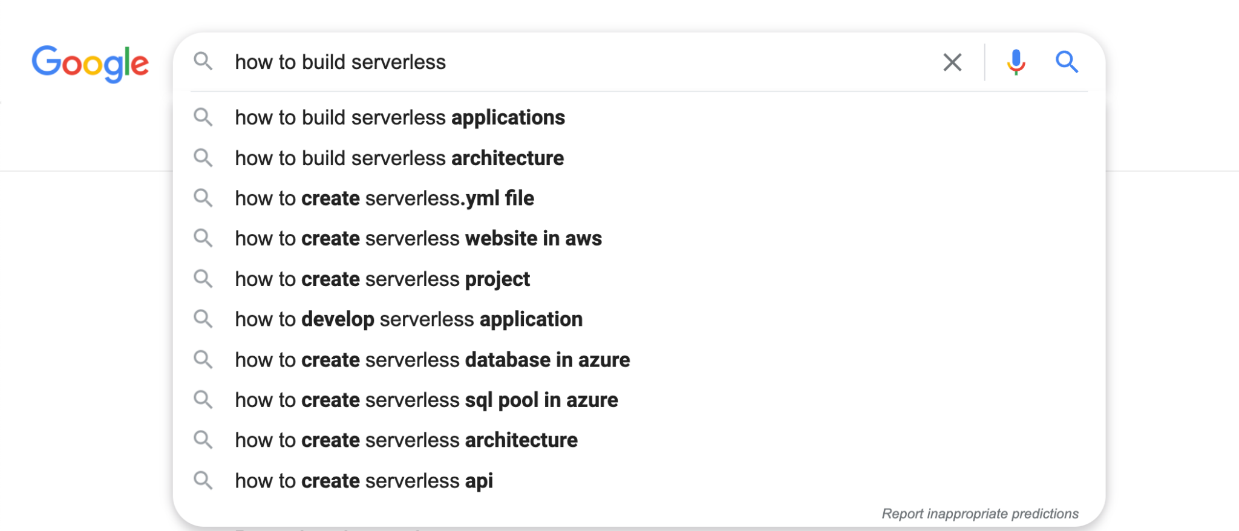

Slide 20
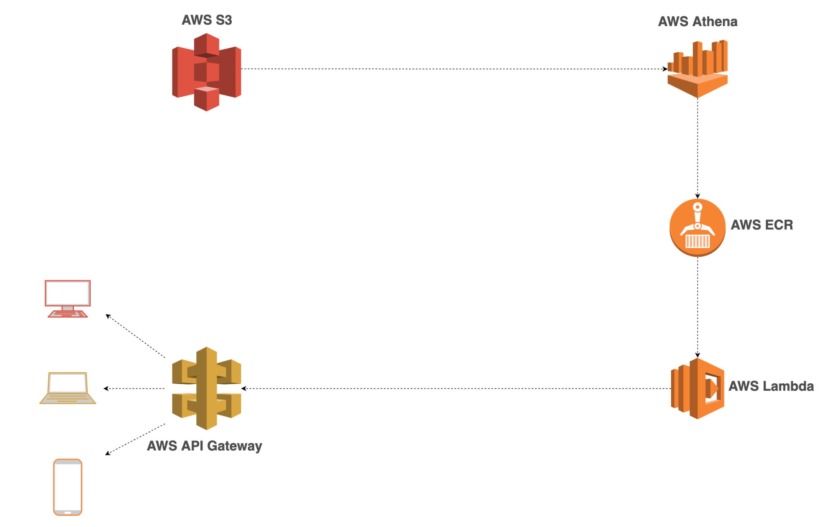
Before giving an example, let’s define some things
Notes:
https://www.serverless.com/blog/when-why-not-use-serverless
https://pauldjohnston.medium.com/when-not-to-use-serverless-jeff-6d054d0e7098

Slide 21
For the sake of time…
I’ve already populated an S3 bucket with data that we’ll retrieve here
I’ve already created our Athena query engine that we’ll use to query our data in S3
Notes:
https://www.serverless.com/blog/when-why-not-use-serverless
https://pauldjohnston.medium.com/when-not-to-use-serverless-jeff-6d054d0e7098

Slide 22
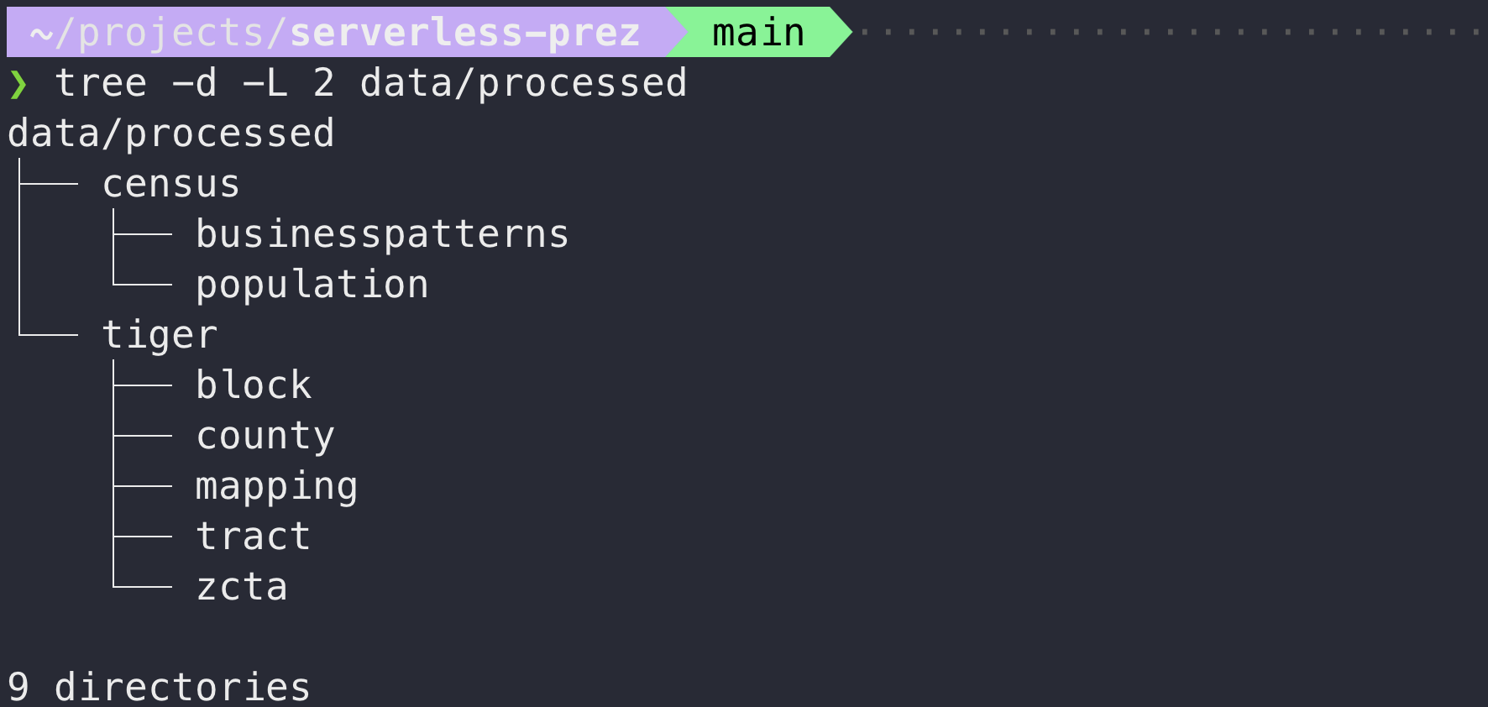
Here’s what our data in S3 looks like
Notes:
https://www.serverless.com/blog/when-why-not-use-serverless
https://pauldjohnston.medium.com/when-not-to-use-serverless-jeff-6d054d0e7098

Slide 23
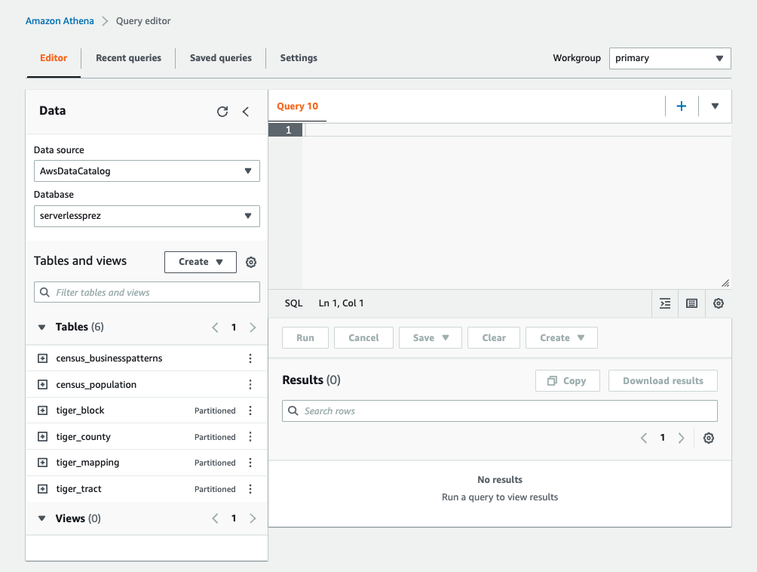
Here’s what our Athena environment looks like
Notes:
https://www.serverless.com/blog/when-why-not-use-serverless
https://pauldjohnston.medium.com/when-not-to-use-serverless-jeff-6d054d0e7098

Slide 24
Now let’s build the rest of it!
Notes:
https://www.serverless.com/blog/when-why-not-use-serverless
https://pauldjohnston.medium.com/when-not-to-use-serverless-jeff-6d054d0e7098

Slide 25
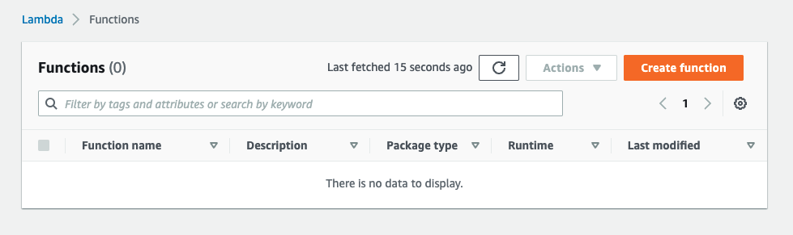
We’ll start with creating our Lambda function
Notes:
https://www.serverless.com/blog/when-why-not-use-serverless
https://pauldjohnston.medium.com/when-not-to-use-serverless-jeff-6d054d0e7098

Slide 26
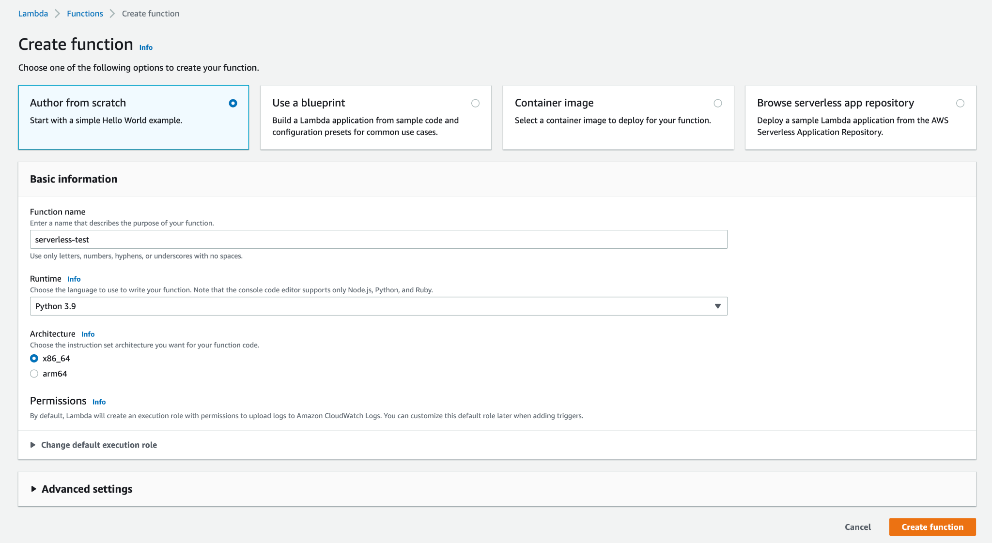
Configure and create

Slide 27
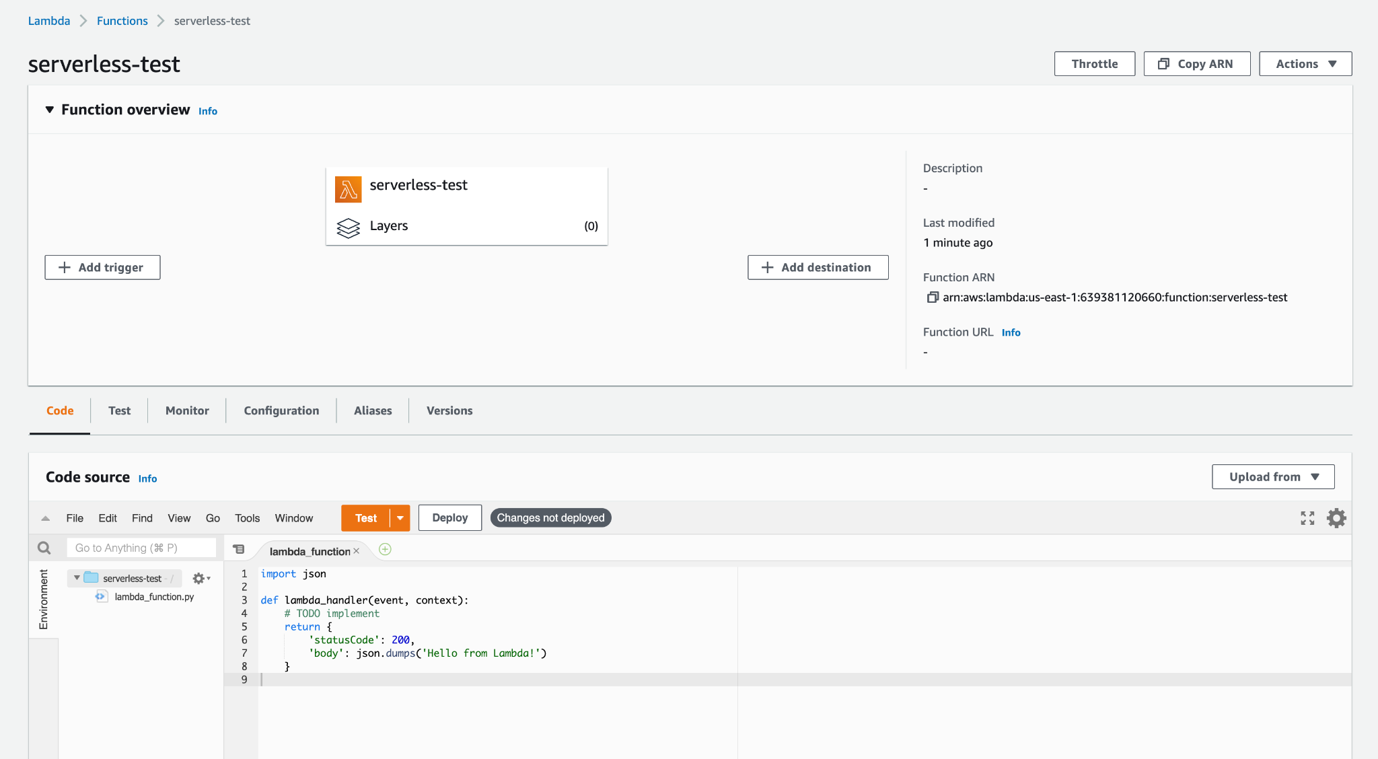
Edit function code

Slide 28
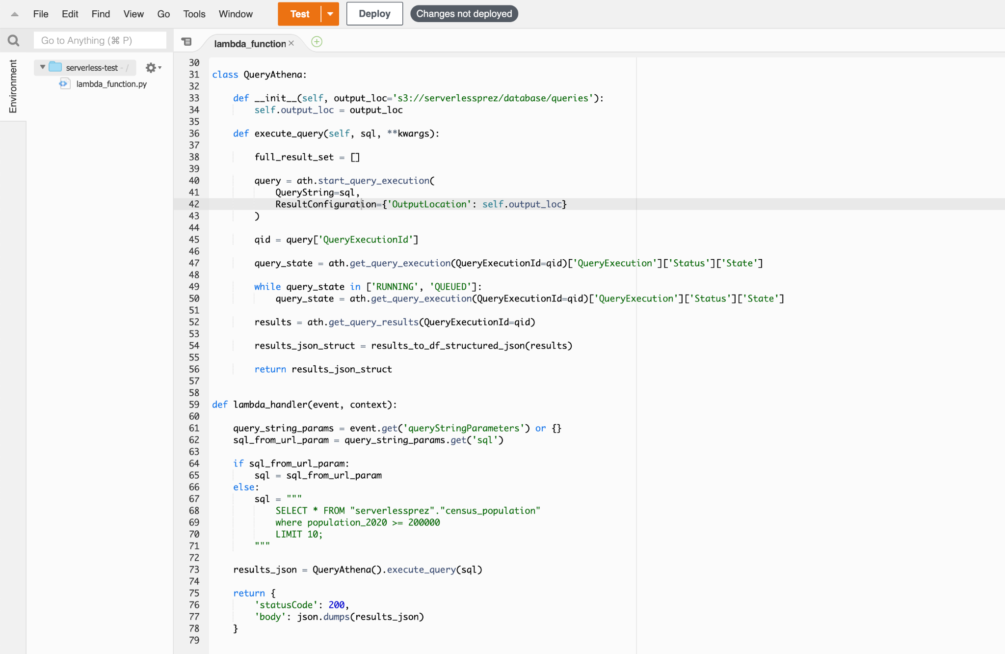
I’ll use code I’ve already written for this

Slide 29
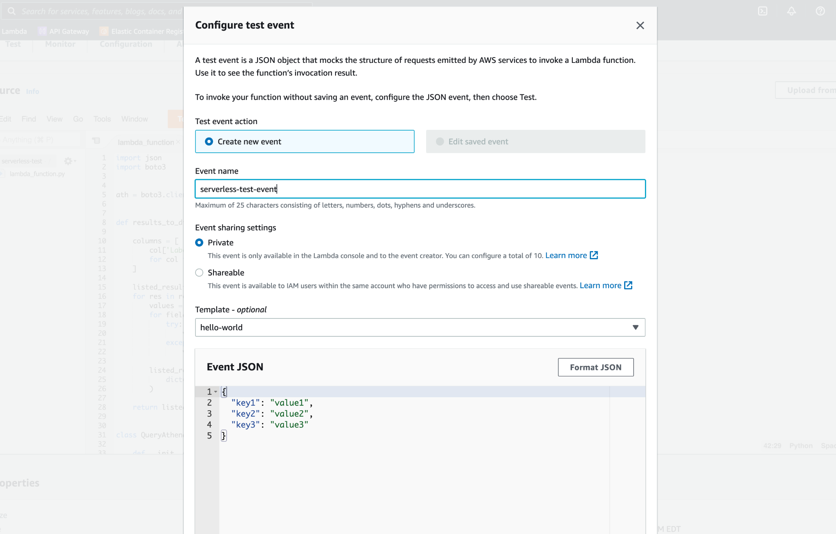
Test our Lambda function before deploying

Slide 30
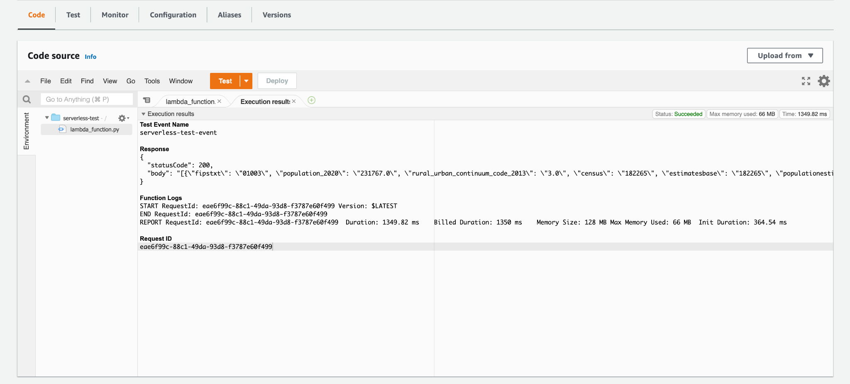
It works!

Slide 31
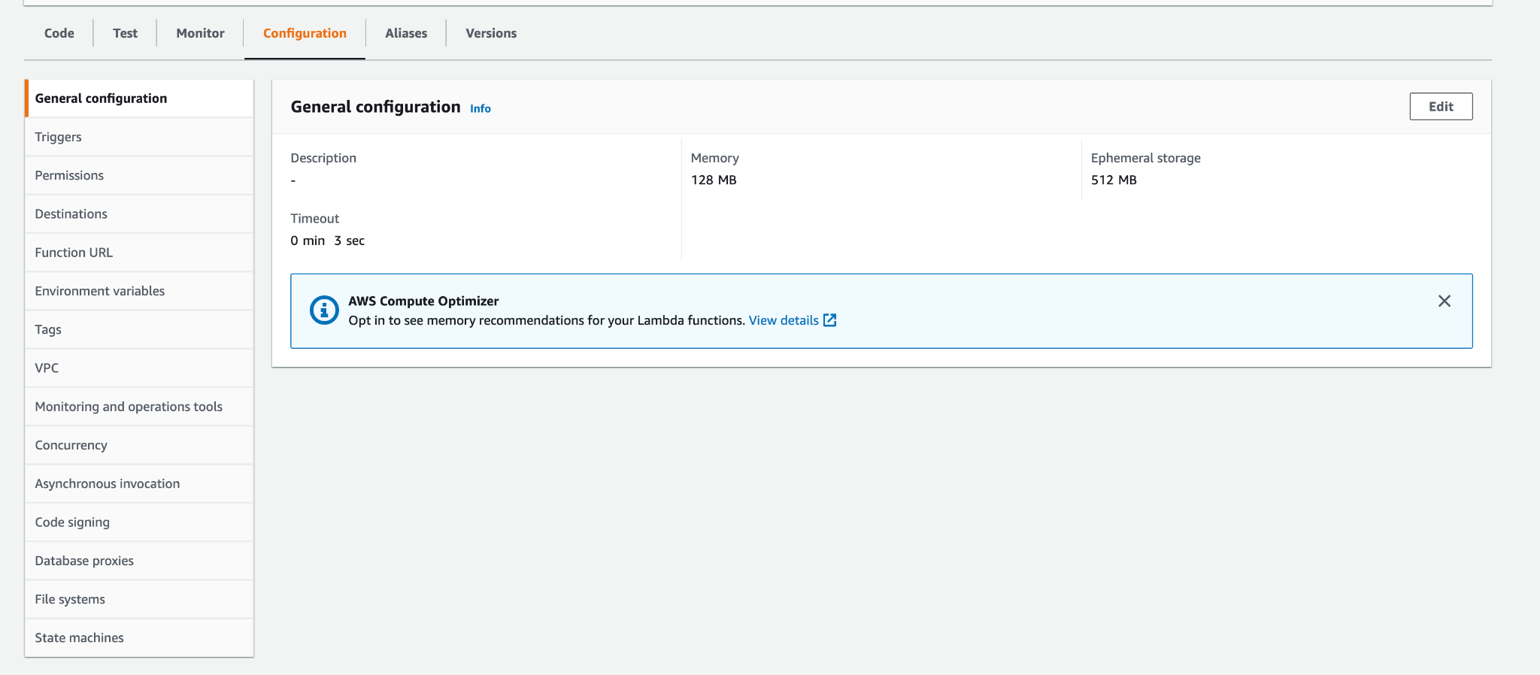
Now let’s extend the timeout and memory

Slide 32
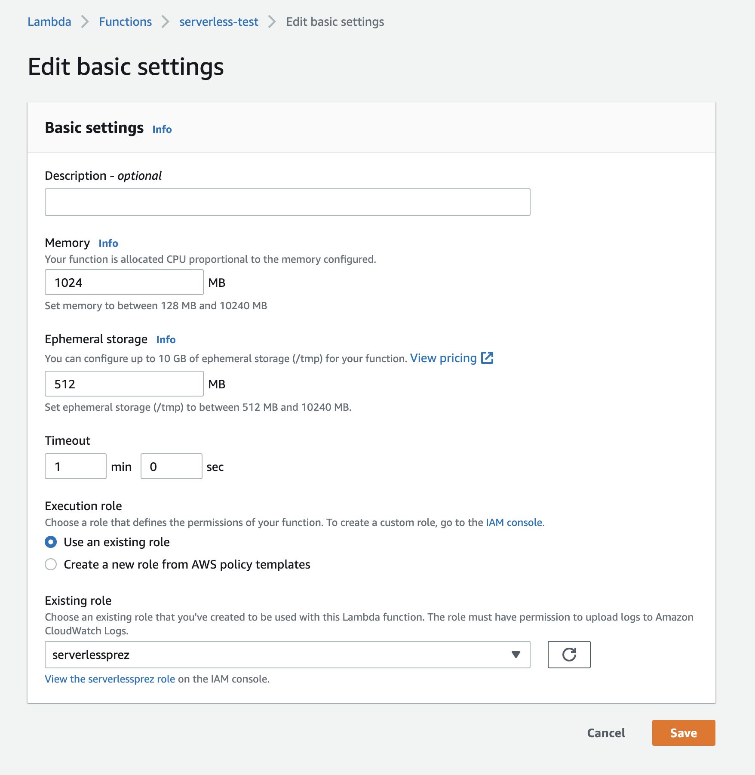
Now let’s extend the timeout and memory

Slide 33
Now let’s make our data accessible over HTTPS

Slide 34
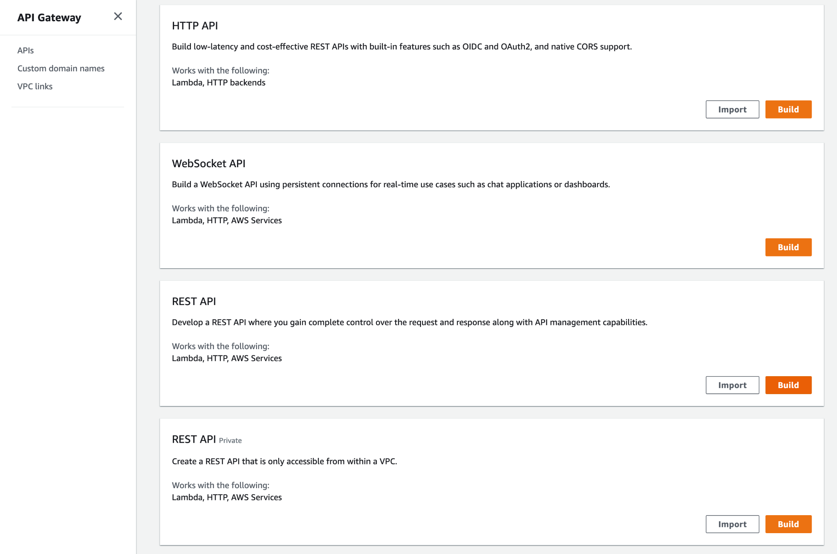
Create an API on AWS API Gateway

Slide 35
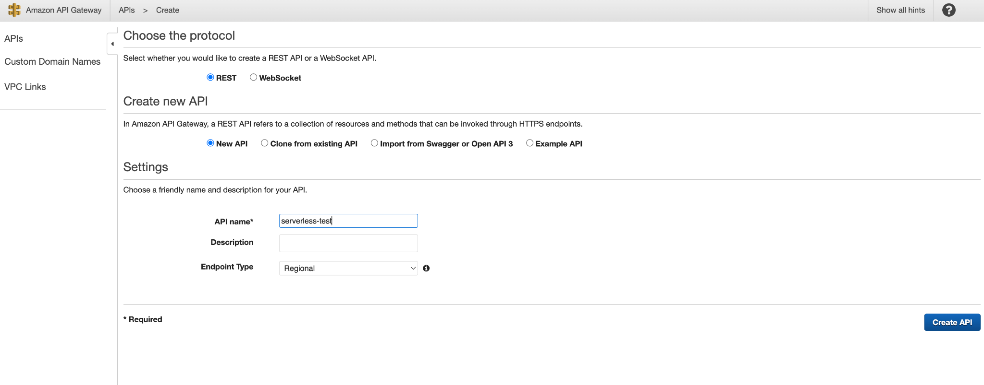
Name the API

Slide 36
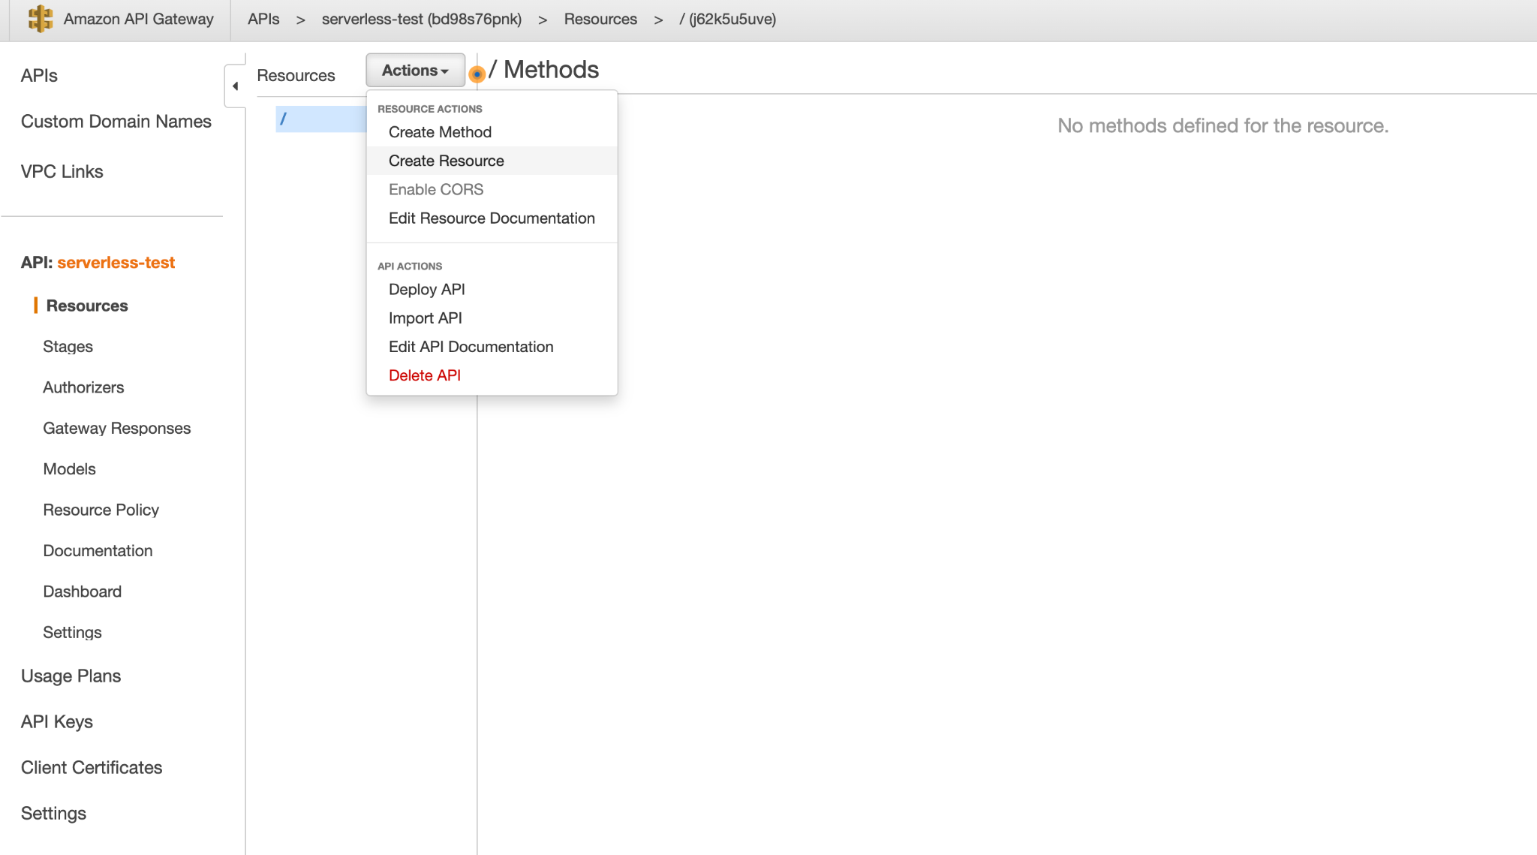
Create a resource on the API

Slide 37
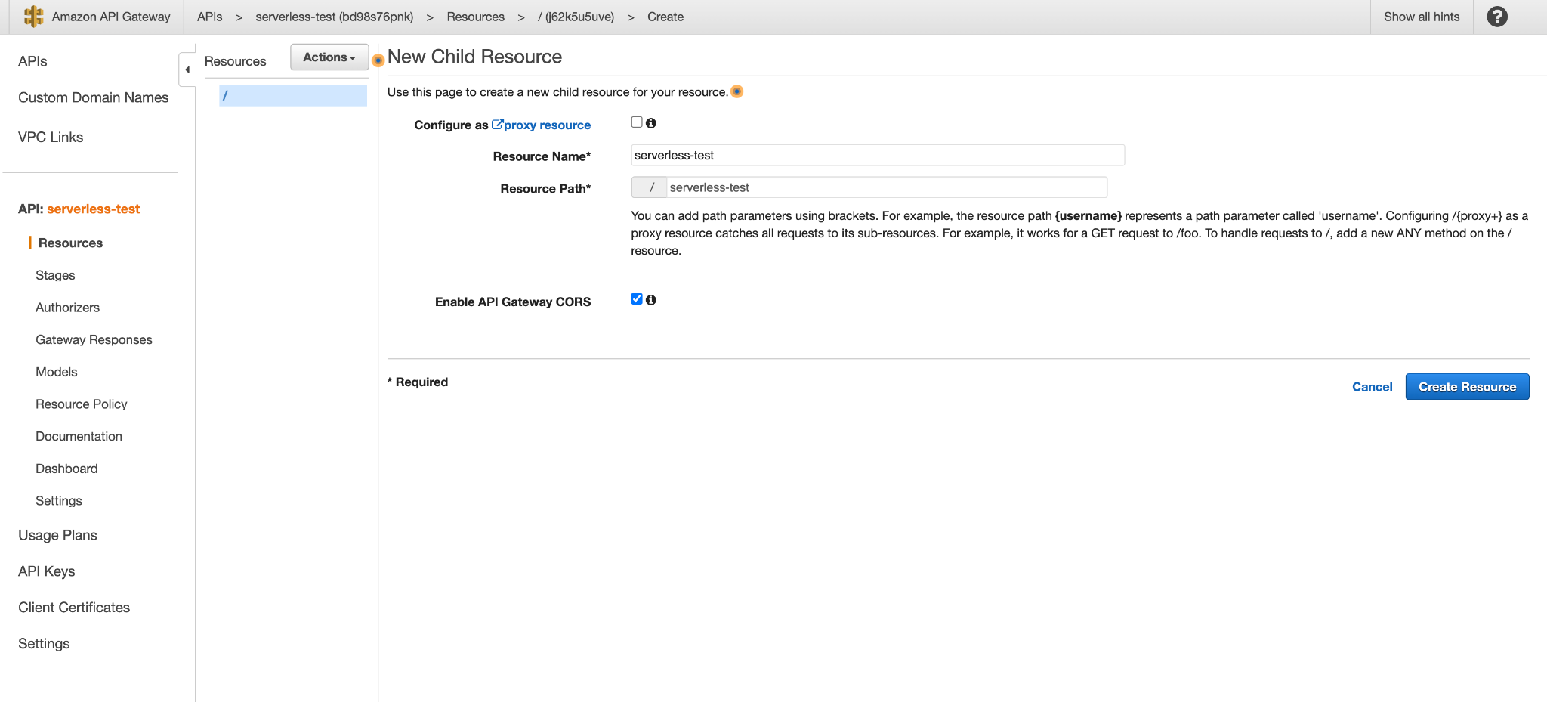
Create a resource on the API

Slide 38
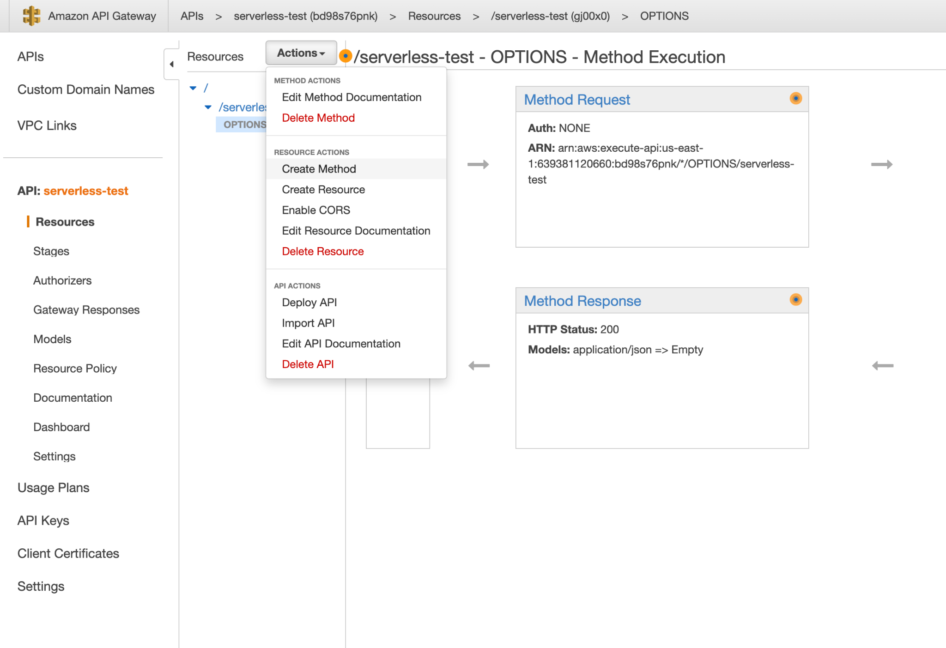
Create a method on the resource

Slide 39
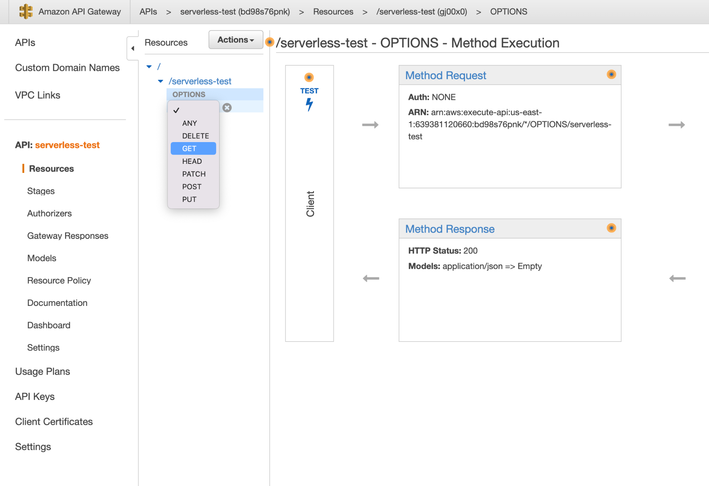
Create a method on the resource

Slide 40
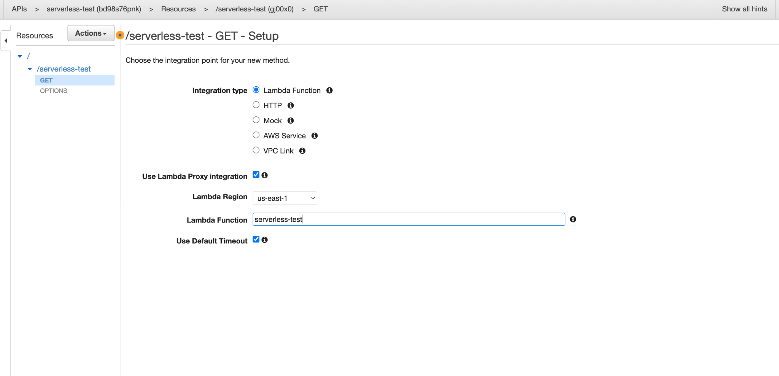
Use the Lambda function as the integration point

Slide 41
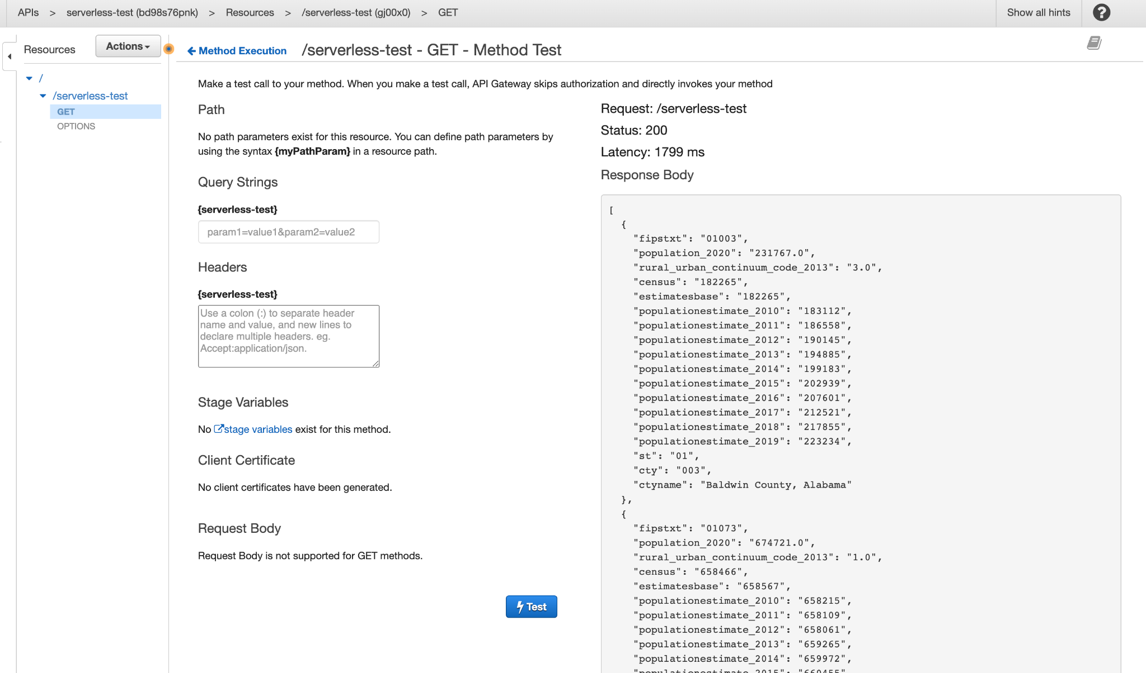
Test it out

Slide 42
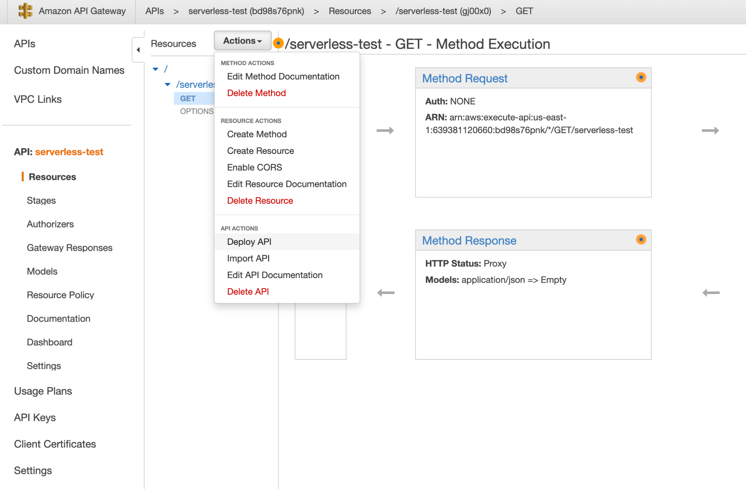
Deploy the API (so we can access it)

Slide 43
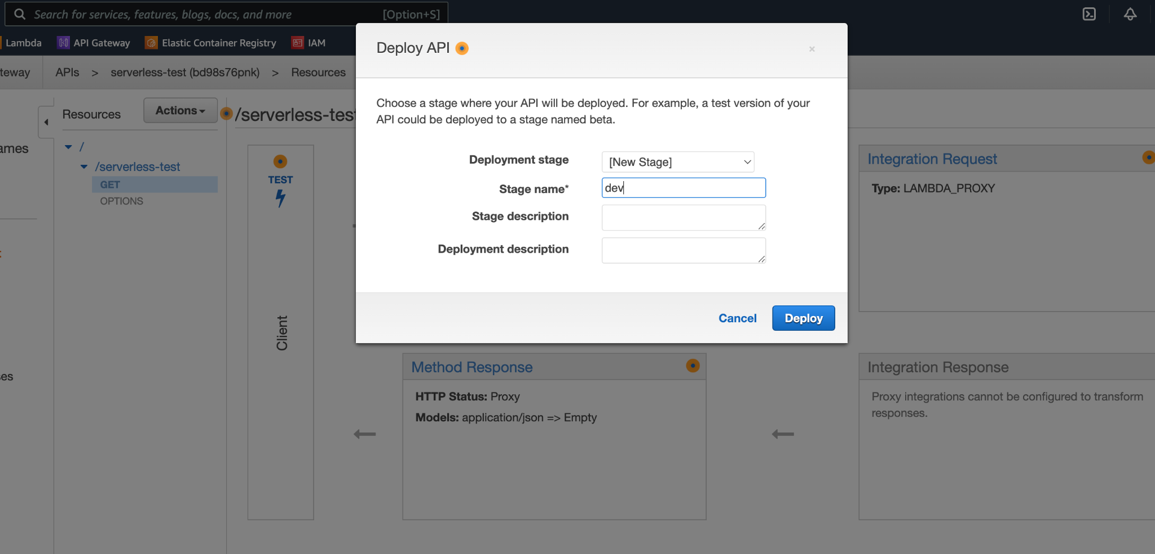
Name the deployment

Slide 44
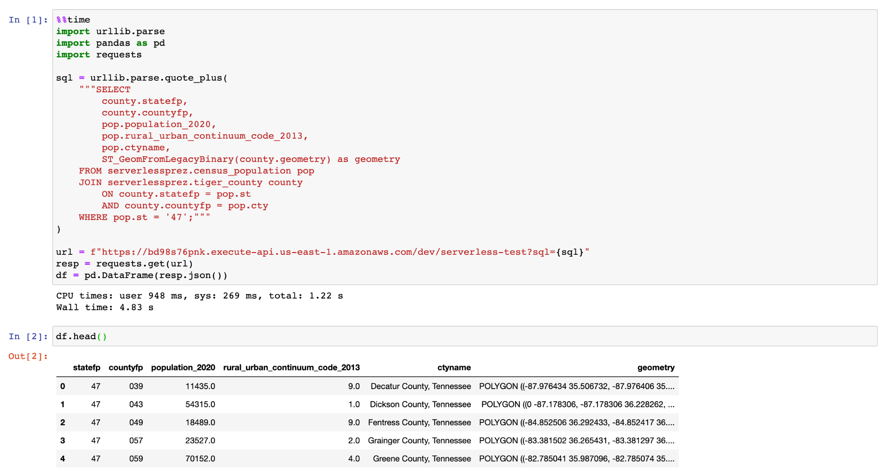
Now let’s call it from Jupyter

Slide 45
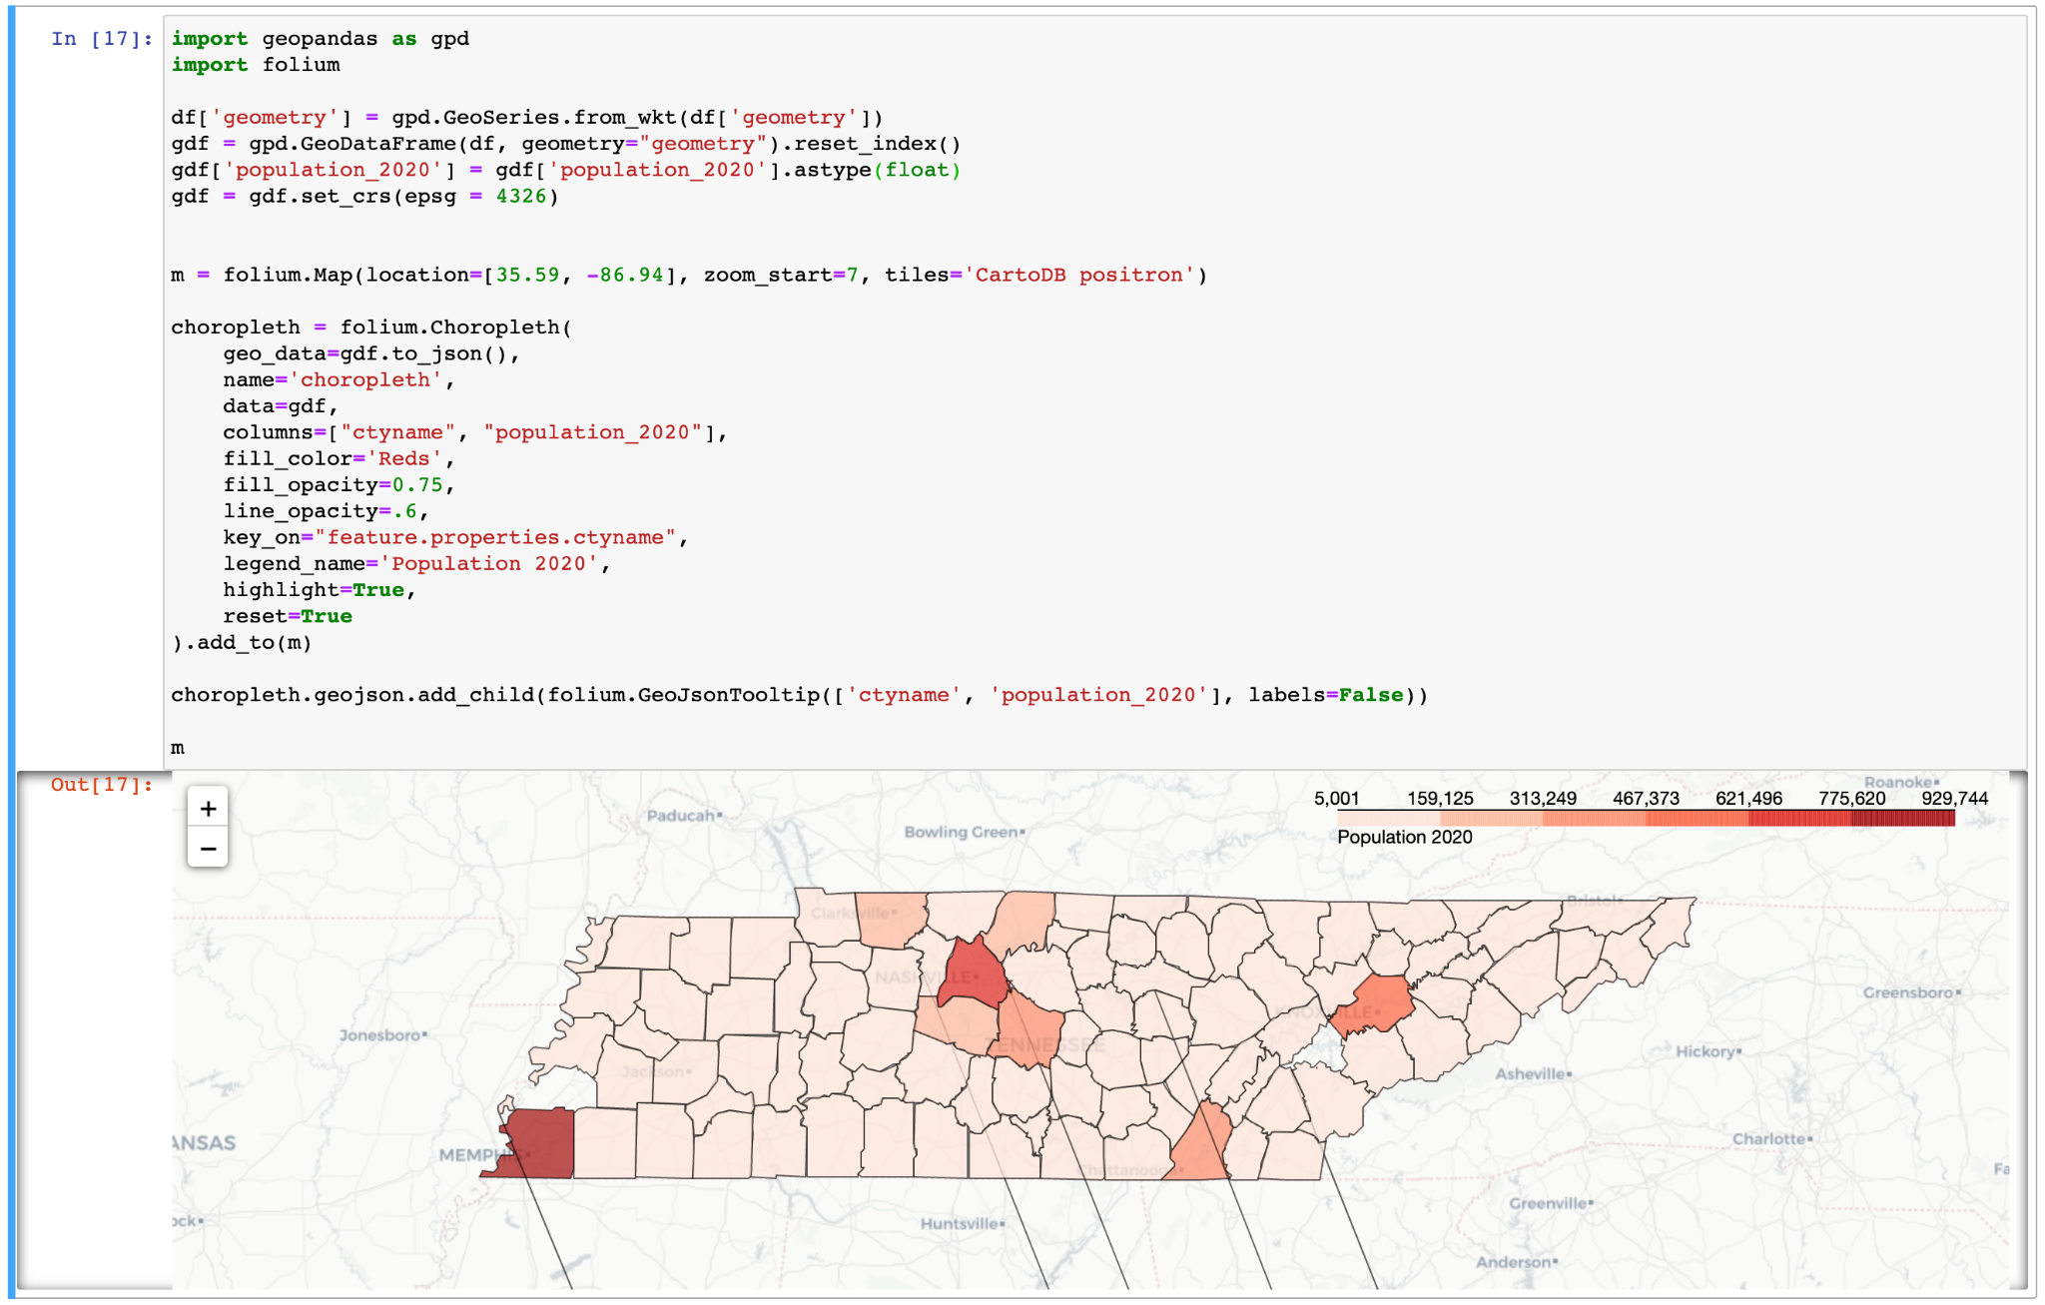
Doing more stuff with that data in Jupyter

Slide 46
How would I have built this using non-serverless?
Create an AWS EC2 instance
Build a postgres database on the EC2 instance
Create the API endpoint using a web framework like Flask or FastAPI
Put the python code behind the Flask resources
Paid too much

Slide 47


Need help with a project or have questions?
Timothy Dobbins
Data Scientist|Data Engineer|Consultant
Github: github.com/tmthyjames
Linkedin: linkedin.com/in/tim-dobbins
Email: tmthyjames@gmail.com
Or scan this →
Presentation Github link: github.com/tmthyjames/serverless-prez

